Slide 1
Operating System [ 4th-Semester]

Slide 2
Topics Covered
Threads
Inter process communication(IPC)
Implementing mutual exclusion
Classical IPC problems

Slide 3
Thread
A thread (or lightweight process)
It consists of : program counter, register set and stack space.
A system registers which hold its current working variables, a stack which contains the execution history and counter that keeps track of which instruction to execute next.
A thread shares the following with peer threads:
Code section, data section and OS resources (open files, signals)
No protection between threads
Collectively called a task.
May have own PBC
Traditional ( heavyweight ) processes have a single thread of control - there is one program counter, and one sequence of instructions that can be carried out at any given time.

Slide 4
Multithreading: a single program made up of a number of different concurrent activities .
An application typically is implemented as a separate process with several threads of control.
A Web browser might have one thread display images or text while another thread retrieves data from the network.
For Example, A word processor may have a thread for displaying graphics, another thread for responding to keystrokes from the user, and a third thread for performing spelling and grammar checking in the background.
In certain situations, a single application may be required to perform several similar tasks. For example, a Web server accepts client requests for Web pages, images, sound, and so forth. A busy Web server may have several clients concurrently accessing it.

Slide 5
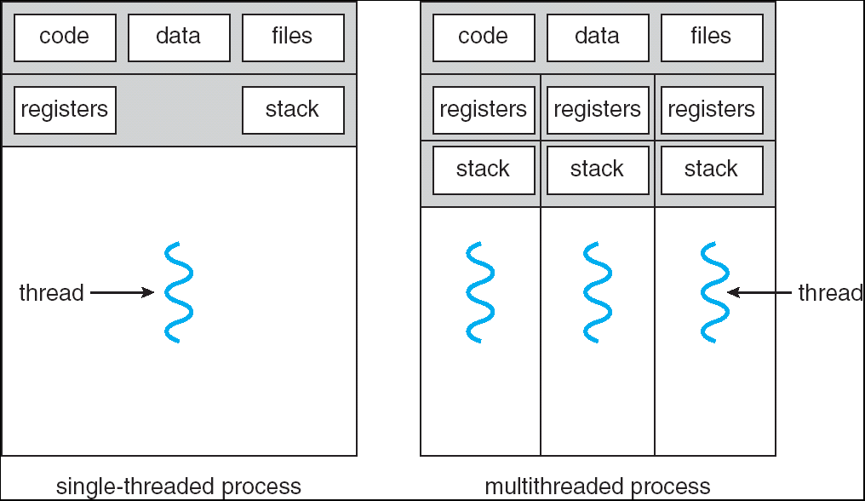
Figure .Single-threaded and multithreaded processes.

Slide 6
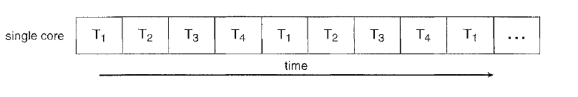
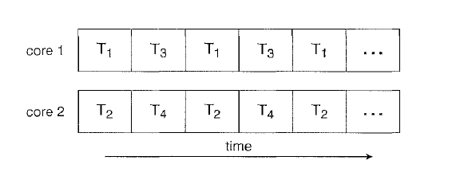
Multicore Programming
Figure .Concurrent execution on a single-core system.
Figure . Parallel execution on a multicore system.

Slide 7
A recent trend in computer architecture is to produce chips with multiple cores, or CPUs on a single chip.
A multi-threaded application running on a traditional single-core chip would have to interleave the threads,
On a multi-core chip, the threads could be spread across the available cores, allowing true parallel processing.

Slide 8
Types of Threads
User threads are supported above the kernel and are managed without kernel support, whereas kernel threads are supported and managed directly by the operating system.
User-level threads
User-level threads are implemented by users and the kernel is not aware of the existence of these threads.
User level thread is also called many-to-one mapping thread because the operating system maps all threads in a multithreaded process to a single execution context. The operating system considers each multithreaded processes as a single execution unit.
User level thread uses space for thread scheduling. The threads are transparent to the operating system

Slide 9
User threads are implemented by users and managed entirely by the run-time system.
If one user level thread performs blocking operation then entire process will be blocked.
Implementation is by a thread library at the user level
User level threads are created by runtime libraries that cannot execute privileged instructions.
User-level threads requires non-blocking systems call i.e., a multithreaded kernel. Otherwise, entire process will blocked in the kernel, even if there are runnable threads left in the processes. For example, if one thread causes a page fault, the process blocks.
Example : Java thread, POSIX threads.

Slide 10
Kernel-supported threads
Supported by the kernel.
Threads are constructed and controlled by system calls. The system knows the state of each thread
Kernel level thread support one-to-one thread mapping. Mapping requires each user thread with kernel thread.
Kernel level threads are implemented by Operating system. In the kernel level thread, thread management is done by kernel.
Implementation of kernel thread is complicated.
Since, kernel managing threads, kernel can schedule another thread if a given thread blocks rather than blocking the entire processes.
Kernel level threads are slower than user level threads
Examples: Windows XP/2000,Solaris 2,Linux,Mac OS X

Slide 11
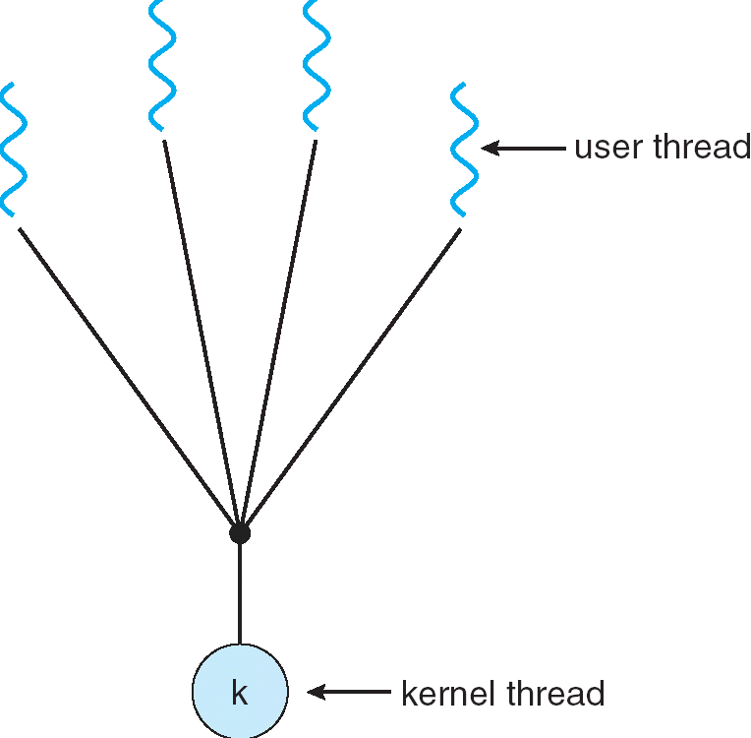
Multithreading Models
Many-to-One
Many user-level threads mapped to single kernel thread
Thread management is done by the thread library in user space
Examples:
Solaris Green Threads
GNU Portable Threads
If one thread initiates a blocking system call, then no other thread in the same process can execute
No parallelism.

Slide 12
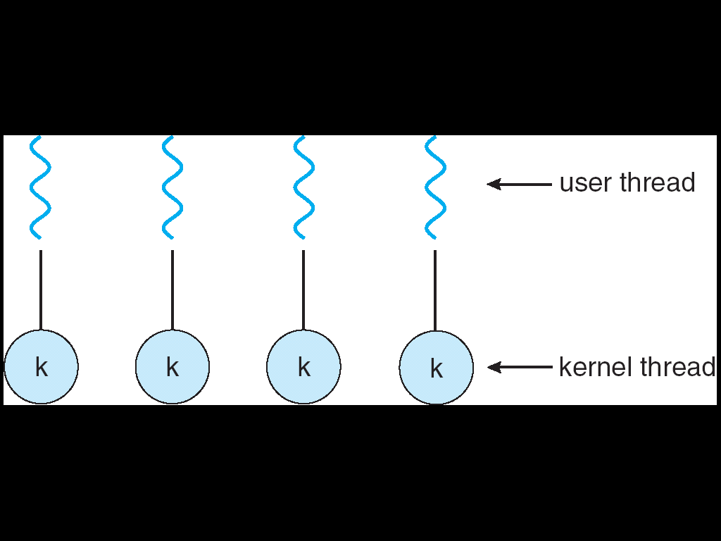
One-to-One
Each user-level thread maps to kernel thread
It provides more concurrency than the many-to-one model by allowing another thread to run when a thread makes a blocking system call.
Allows multiple threads to run in parallel on multiprocessors.
Examples: Windows NT/XP/2000; Linux; Solaris 9 and later
Drawback: Creating a user thread requires creating the corresponding kernel thread

Slide 13
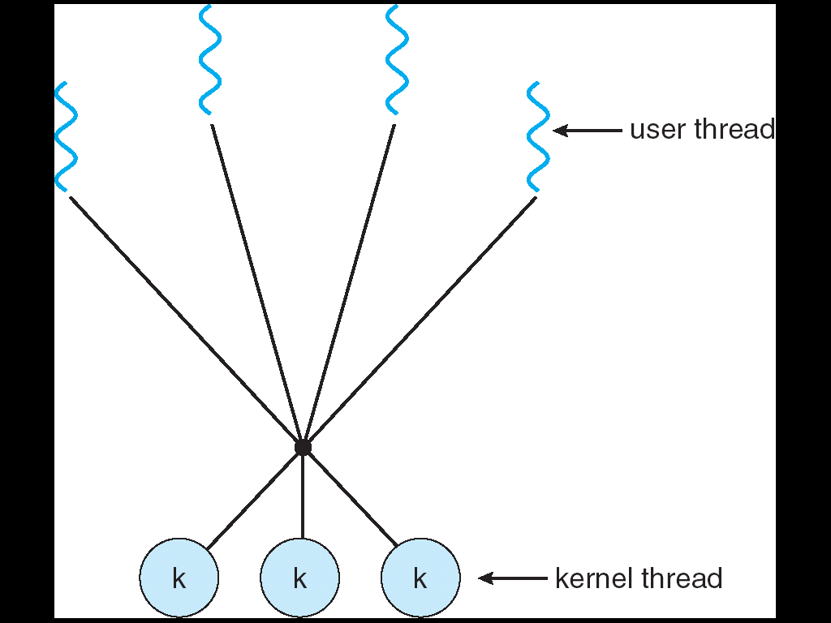
Many-to-Many Model
Allows many user level threads to a smaller or equal number of kernel threads.
Allows the operating system to create a sufficient number of kernel threads
Users have no restrictions on the number of threads created.
Blocking kernel system calls do not block the entire process.
Processes can be split across multiple processors.
Solaris prior to version 9,Windows NT/2000 with the ThreadFiber package

Slide 14
Threads: benefits
User responsiveness: When one thread blocks, another may handle user I/O
But: depends on threading implementation
Resource sharing: Memory is shared (i.e., address space shared)
Open files, sockets shared
Economy: Creating a thread is fast
Context switching among threads may be faster
Speed: E.g., Solaris: thread creation about 30x faster than heavyweight process creation; context switch about 5x faster with thread
Utilizing hardware parallelism: Like heavy weight processes, can also make use of multiprocessor architectures

Slide 15
Interprocess Communication(IPC)
Inter-process communication is used for exchanging data between multiple threads in one or more processes or program and synchronize the data.
There are numerous reasons for providing an environment or situation which allows process co-operation:
Information sharing: exchange the information
Computation speedup: If you want a particular work to run fast, you must break it into sub-tasks where each of them will get executed in parallel with the other tasks.
Modularity: Build the system in a modular way by dividing the system functions into split processes or threads.
Convenience: Even a single user may work on many tasks at a time. For example, a user may be editing, formatting, printing, and compiling in parallel.

Slide 16
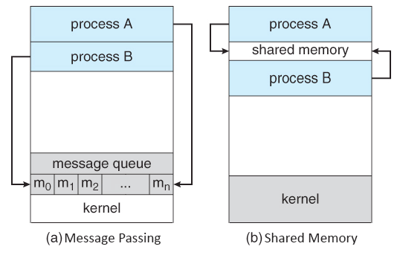
There are two primary models of Interprocess Communication:

Slide 17
In the shared memory system, the cooperating process which wants to initiate the communication establishes a region of shared memory in its address space. The other cooperative process which requires the shared data has to attach itself to the address space of the initiating process.
The process A has some data, to share with process B. Process A has to take the initiative and establish a shared memory region in its own address space and store the data or information to be shared in it’s shared memory region.
Process B requires the information stored in the shared segment of the A. So, process B has to attach itself to the shared address space of A. Now, B can read out the data from there.
Process A and B can exchange information or data by reading and writing data in the shared segment of the process.
The message-passing system shares the data by passing the messages. If a process needs to share the data, it writes the data in the message and passes it on to the kernel. The process that requires the shared data read it out from the kernel.

Slide 18
Race Conditions
Process Synchronization is a mechanism that deals with the synchronization of processes. It controls the execution of processes running concurrently to ensure that consistent results are produced.
The situation where two or more processes reading or writing some share data and the final results depends on who runs precisely when are called Race conditions.
A race condition occurs when two processes can interact and the outcome depends on the order in which the processes execute.
When a process wants to print a file, it enters the file name in a special spooler directory.
Imagine that our spooler directory has a very large number of slots, numbered 0, 1, 2, ..., each one capable of holding a file name.
At a certain instant, slots 0 to 3 are empty (the files have already been printed) and slots 4 to 6 are full (with the names of files queued for printing).

Slide 19
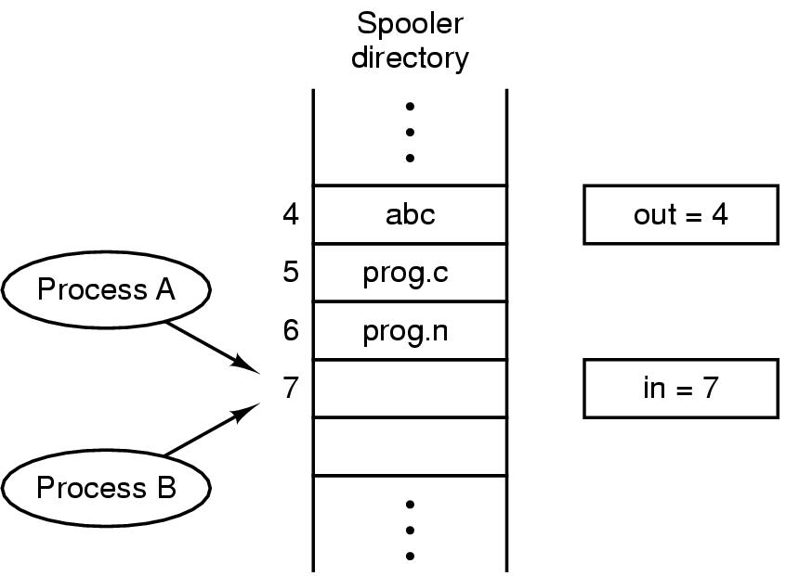
Figure .Two processes want to access shared memory at same time

Slide 20
An operating system is providing printing services, “printer system process ” picks a print job from spooler. Each job gets a job number, and this is done by the spooler using two global variables “in” and “out”.
Process A reads in and stores the value, 7, in a local variable called next free slot. Just then a clock interrupt occurs and the CPU decides that process A has run long enough, so it switches to process B.
Process B also reads in, and also gets a 7, so it stores the name of its in slot 7 and update into be an 8. Then it goes off and does other things.
Eventually, process A runs again, starting from the place it left off. It looks at next free slot, finds a 7 there, and writes its file name in slot 7, erasing the name that process B just put there. Then it computes next free slot + 1, which is 8, and sets in to 8.
The spooler directory is now internally consistent, so the printer daemon will not notice anything wrong, but process B will never receive any output.

Slide 21
Critical Regions
That part of the program where the shared memory is accessed is called the critical region or critical section.
Atomic action is required in a critical section i.e. only one process can execute in its critical section at a time. All the other processes have to wait to execute in their critical sections.
To avoid race condition we need mutual exclusion.
Mutual exclusion: Mechanism which makes sure that two or more processes do not access a common resource at the same time.
The difficulty in printer spooler occurs because process B started using one of the shared variables before process A was finished with it. If we could arrange matter such that no two processes were ever in there critical regions at the same time, we could avoid race conditions.

Slide 22
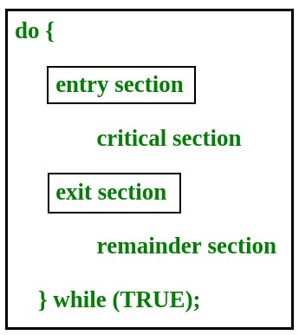
Solution to Critical Section Problem:
No two processes may be simultaneously inside their critical regions.
No process running outside its critical region may block any process.
No process should have to wait forever to enter its critical region.

Slide 23
Requirements of Synchronization mechanisms Mutual Exclusion
Our solution must provide mutual exclusion. By Mutual Exclusion, we mean that if one process is executing inside critical section then the other process must not enter in the critical section.
Progress
Progress means that if one process doesn't need to execute into critical section then it should not stop other processes to get into the critical section.
Bounded Waiting
We should be able to predict the waiting time for every process to get into the critical section. The process must not be endlessly waiting for getting into the critical section.

Slide 24
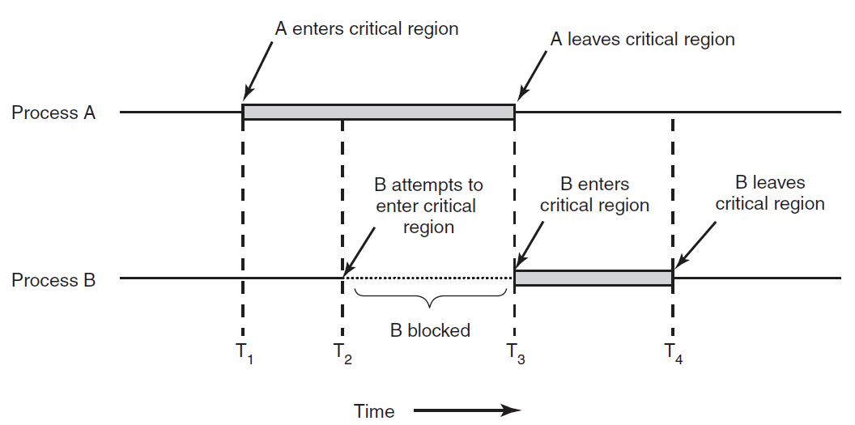
Example :
process A enters its critical region at time T1. A little later, at time T2 process B attempts to enter its critical region but fails because another process is already in its critical region and we allow only one at a time.
Process B is temporarily suspended until time T3 when A leaves its critical region, allowing B to enter immediately. Eventually B leaves (at T4) and we are back to the original situation with no processes in their critical regions.
Figure . Mutual exclusion using critical regions.

Slide 25
Mutual Exclusion with Busy Waiting
Proposals for achieving mutual exclusion:
Disabling interrupts
Lock variables
Strict alternation
Peterson's solution
The TSL instruction

Slide 26
Disabling interrupts
Simplest solution, After entering critical region, disable all interrupts
The CPU is only switched from process to process as a result of clock or other interrupts, after all, and with interrupts turned off the CPU will not be switched to another process.
May be used inside operating system kernel when some system Structures are to be updated, but is not recommended for Implementation of mutual exclusion in user space.
Advantage: process inside critical region may update shared resources Without any risk of races
Disadvantage: if after leaving the region interrupts are not reenabled There will be a crash of the system. Moreover: useless in multiprocessor Architectures.

Slide 27
Lock variables
Software solution at user level, multiprogram med solution.
A software solution. Considering having a single, shared lock variable, initially 0.
When a process wants to enter critical region, it first tests the lock.
If the lock = 0, the process sets it to 1 and enters the critical region.
If the lock is already 1, the process just waits until it becomes 0. Thus, a 0 means that no process is in its critical region, and a 1 means that some process is in its critical region.
The pseudo code of the mechanism looks like following.
Entry Section →
While (lock! = 0);
Lock = 1;
//Critical Section
Exit Section →
Lock =0;

Slide 28
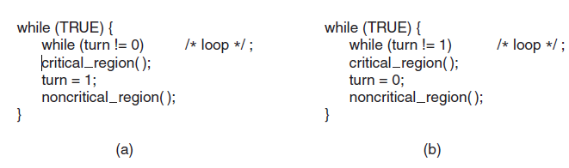
Strict Alternation/Turn Variable
Figure. A proposed solution to the critical region problem. (a) Process P0. (b) Process P1. In both cases, be sure to note the semicolons terminating the while statements.

Slide 29
Turn Variable or Strict Alternation Approach is the software mechanism implemented at user mode.
It keeps track of whose turn it is to enter the critical region and examine or update the shared memory.
Initially, process P0 inspects turn, finds it to be 0, and enters its critical region. Process P1 also finds it to be 0 and therefore sits in a tight loop continually testing turn to see when it becomes 1.
Continuously testing a variable until some value appears is called busy waiting. It should usually be avoided, since it wastes CPU time. A lock that uses busy waiting is called a spin lock.
When process P0 leaves the critical region, it sets turn to 1, to allow process P1 to enter its critical region. This way no two process can enters critical region simultaneously.

Slide 30
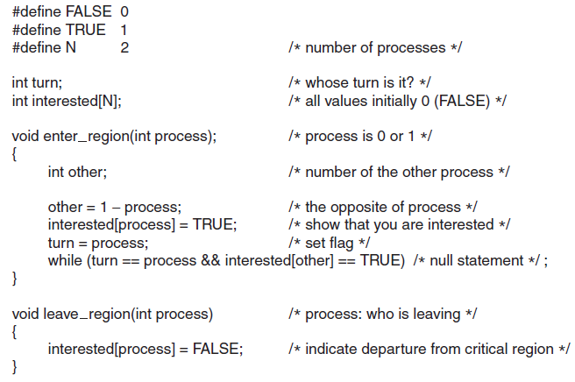
Peterson’s Solution
Figure . Peterson’s solution for achieving mutual exclusion.

Slide 31
Peterson's solution is used for mutual exclusion and allowed to processes to share a single use resource without conflict. It uses only shared memory for communication.
Peterson's solution originally worked only with two processes, but has been generalized for more than two.
Initially neither process is in its critical region. Now process 0 calls enter region. It indicates its interest by setting its array element and sets turn to 0. Since process 1 is not interested, enter region returns immediately.
If process 1 now makes a call to enter region, it will hang there until interested[0] goes to FALSE, an event that happens only when process 0 calls leave region to exit the critical region.
Now consider the case that both process call "Enter Region" almost simultaneously. Then both will store the process number in 'turn'. Which ever store is done last is the one that counts the first one is overwritten and lost. Suppose that process 1 stores last, so 'turn' is 1, when both processes come to the while statement, process 0 executes it zero times and enters its critical region.
Process 1 loops and does not enter a critical region until process 0 exit its critical region.

Slide 32
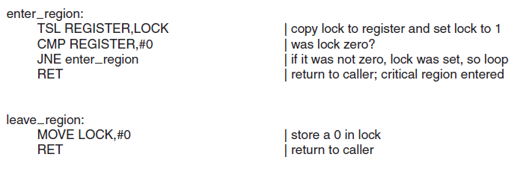
TSL Instruction
Figure . Entering and leaving a critical region using the TSL instruction.

Slide 33
Software solution has many problem like, high processing overhead, logical errors etc.
Hardware solution, multiprocess solution(n>=2), some computer architectures offer an instruction TEST AND SET LOCK (TSL).
TSL RX,LOCK
(Test and Set Lock) that works as follows: it reads the contents of the memory word LOCK into register RX and then stores a nonzero value at the memory address LOCK.
The operations of reading the word and storing into it are guaranteed to be indivisible no other processor can access the memory word until the instruction is finished.
The CPU executing the TSL instruction locks the memory bus to prohibit other CPUs from accessing memory until it is done.

Slide 34
Sleep and Wakeup
When a process is not permitted to access its critical section, it uses a system call known as sleep, which causes that process to block. The process will not be scheduled to run again, until another process uses the wakeup system call.
In most cases, wakeup is called by a process when it leaves its critical section if any other processes have blocked.
There is a popular example called producer consumer problem which is the most popular problem simulating sleep and wake mechanism.
The problem describe two processes, User and Consumer, who share a common fixed size buffer. Producer consumer problem also known as the "Bounded Buffer Problem" is a multi-process synchronization problem.
Disadvantage: wakeup signal may be lost, which leads to deadlock.

Slide 35
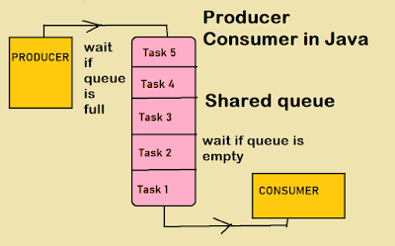

Slide 36
Producer: The producer's job is to generate a bit of data, put it into the buffer and start again.
Consumer: The consumer is consuming the data (i.e remaining it from the buffer) one piece at a time.
If the buffer is empty, then a consumer should not try to access the data item from it. Similarly, a producer should not produce any data item if the buffer is full.
Counter: It counts the data items in the buffer. or to track whether the buffer is empty or full. Counter is shared between two processes and updated by both.
How it works?
• Counter value is checked by consumer before consuming it.
• If counter is 1 or greater than 1 then start executing the process and updates the counters.
• Similarly producer check the buffer for the value of Counter for adding data.
• If the counter is less than its maximum values, it means that there is some space in Buffer.

Slide 37
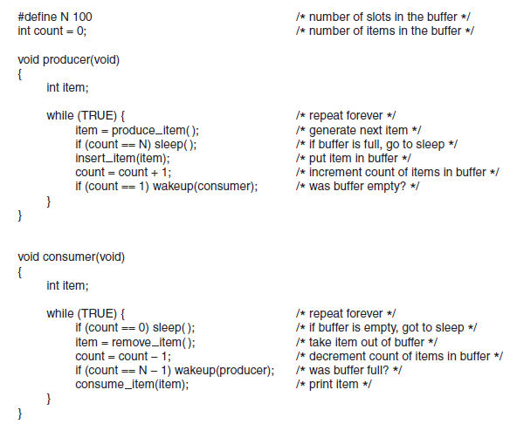
Figure. The producer-consumer problem with a fatal race condition.

Slide 38
Types of mutual exclusion
Semaphores
Monitors
Locks (mutexes)
Message passing
Bounded Buffer (Producer consumer )

Slide 39
Semaphores
In 1965, when E. W. Dijkstra (1965) suggested using an integer variable to count the number of wakeups saved for future use.
Proposed variable or abstract datatype called semaphore ,A semaphore could have the value 0, indicating that no wakeups were saved, or some positive value if one or more wakeups were pending.
Dijkstra proposed having two operations on semaphores, now usually called down and up (generalizations of sleep and wakeup). he used the names P and V instead of down/wait and up/signal.
The down operation on a semaphore checks to see if the value is greater than 0. If so, it decrements the value (i.e., uses up one stored wakeup) and just continues.
If the value is 0, the process is put to sleep without completing the down for the moment. Checking the value, changing it, and possibly going to sleep, are all done as a single, indivisible atomic action.

Slide 40
Two operations which can be used to access and change the value of semaphore variable.
Wait (s){
While(s==0); /* wait until s=0*/ initially s=1
S=s-1;
}
signal( s){
S=s+1;
}

Slide 41
This solution uses three semaphores: one called full for counting the number of slots that are full, one called empty for counting the number of slots that are empty, and one called mutex to make sure the producer and consumer do not access the buffer at the same time.
Semaphores that are initialized to 1 and used by two or more processes to ensure that only one of them can enter its critical region at the same time are called binary semaphores, only takes the values 0 and 1 during execution of a program. Hence it is often called a mutex
Counting semaphore can be used when we need to have more than one process in the critical section at the same time.
Counting = -∞ to +∞, Binary=0,1
It is a very popular tool used for process synchronization.

Slide 42
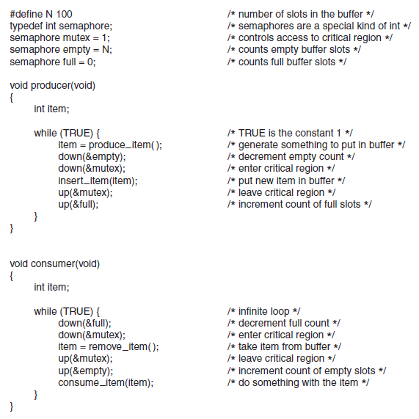
Figure. The producer-consumer problem using semaphores.

Slide 43
Monitors
To make it easier to write correct programs, brinch hansen (1973) and hoare (1974) proposed a higher-level synchronization primitive called a monitor.
A monitor is a collection of procedures,
Variables, and data structures that are all
Grouped together in a special kind of module
Or package.
Monitor is same as a class type: like
object of class are created, the variable
of monitor type are defined.
Figure. A monitor.

Slide 44
Advantages of Semaphore
It allows more than one thread to access the critical section
Semaphores are machine-independent.
Semaphores are implemented in the machine-independent code of the microkernel.
They do not allow multiple processes to enter the critical section.
As there is busy waiting in semaphore, there is never a wastage of process time and resources.
They are machine-independent, which should be run in the machine-independent code of the microkernel.
They allow flexible management of resources
Disadvantage of Semaphores
Semaphore programming is a complex method, so there are chances of not achieving mutual exclusion.
Semaphore is more prone to programmer error.
It may cause deadlock or violation of mutual exclusion due to programmer error.

Slide 45
Message Passing
This method of interprocess communication uses two primitives, send and receive, which, like semaphores and unlike monitors, are system calls rather than language constructs.
send(destination, &message);
and
receive(source, &message);
two methods of message addressing:
Direct addressing, each process contains unique address. The following rendezvous mechanism may be used:
If send called before receive, the sending process suspended till the moment of the very message sending after receive call,
If receive called before send, the receiving process suspended till the moment of the very message sending after send call.

Slide 46
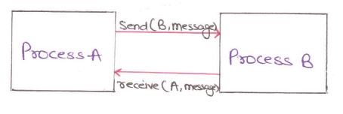
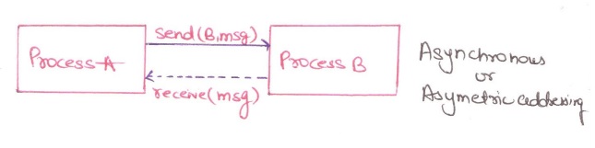
Example:
If process A sends a message to process B, then
Send(B, message); Receive(A, message);
By message passing a link is established between A and B. Here the receiver knows the Identity of sender message destination. This type of arrangement in direct communication is known as Symmetric Addressing.
Another type of addressing known as asymmetric addressing where receiver does not know the ID of the sending process in advance.

Slide 47
Indirect addressing, via some mailbox playing the role of the Intermediate buffer. Send and receive has as an argument mailbox Address, not the address of any particular process.
The sender and receiver processes should share a mailbox to communicate.

Slide 48
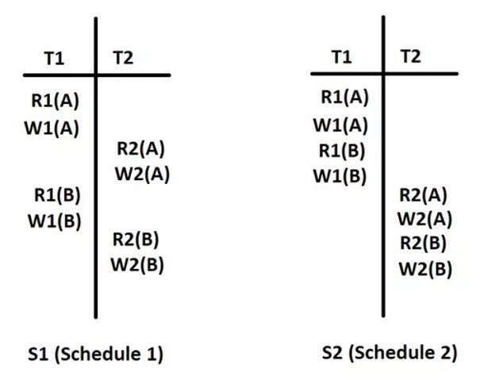
Serializability
When multiple transactions are running concurrently then there is a possibility of that the database may be left in an inconsistent state.Seralizability is concept that helps us to check which schedules are serializable.
View Serializability:
This type of serializability is the same as a serial schedule where respective transactions are equipped with the same sets in chronological order without overlapping. Have a look at the below example for knowing view serializability below:

Slide 49
Locking protocols
Lock Based Protocols in DBMS is a mechanism in which a transaction cannot Read or Write the data until it acquires an appropriate lock. Lock based protocols help to eliminate the concurrency problem in DBMS for simultaneous transactions by locking or isolating a particular transaction to a single user.
Binary Locks: A Binary lock on a data item can either locked or unlocked states.
Shared/exclusive: This type of locking mechanism separates the locks in DBMS based on their uses. If a lock is acquired on a data item to perform a write operation, it is called an exclusive lock.
Shared Lock (S):A shared lock is also called a Read-only lock. With the shared lock, the data item can be shared between transactions. This is because you will never have permission to update data on the data item.

Slide 50
Locking protocols
2. Exclusive Lock (X):
With the Exclusive Lock, a data item can be read as well as written. This is exclusive and can’t be held concurrently on the same data item. X-lock is requested using lock-x instruction. Transactions may unlock the data item after finishing the ‘write’ operation.
Two Phase Locking Protocol
also known as 2PL protocol is a method of concurrency control in Data base system that ensures serializability by applying a lock to the transaction data which blocks other transactions to access the same data simultaneously. Two Phase Locking protocol helps to eliminate the concurrency problem in Data base system.
This locking protocol divides the execution phase of a transaction into three different parts.
In the first phase, when the transaction begins to execute, it requires permission for the locks it needs.
The second part is where the transaction obtains all the locks. When a transaction releases its first lock, the third phase starts.
In this third phase, the transaction cannot demand any new locks. Instead, it only releases the acquired locks.

Slide 51
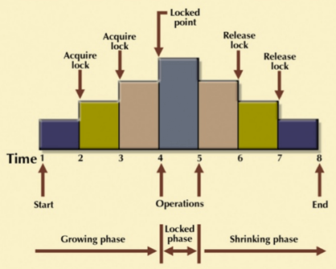
Two Phase Locking Protocol
The Two-Phase Locking protocol allows each transaction to make a lock or unlock request in two steps:
Growing Phase: In this phase transaction may obtain locks but may not release any locks.
Shrinking Phase: In this phase, a transaction may release locks but not obtain any new lock

Slide 52
Classical IPC Problems
The Dining philosopher problem
In 1965, Dijkstra posed and then solved a synchronization problem he called the dining philosophers problem.
Five philosophers are seated around a circular table. Each philosopher has a plate of spaghetti. The spaghetti is so slippery that a philosopher needs two forks to eat it. Between each pair of plates is one fork.
A philosopher either eat or think
When a philosopher gets sufficiently hungry, she tries to acquire her left and right forks, one at a time, in either order. If successful in acquiring two forks, she eats for a while, then puts down the forks, and continues to think.

Slide 53
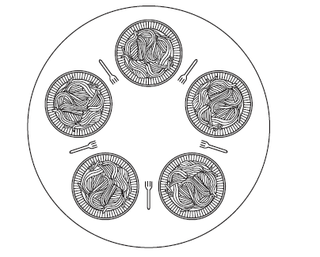
Figure . Lunch time in the Philosophy Department.

Slide 54
#define N 5 /* number of philosophers */
void philosopher(int i) /* i: philosopher number, from 0 to 4 */
{
while (TRUE) {
think( ); /* philosopher is thinking */
take fork(i); /* take left for k */
take fork((i+1) % N); /* take right for k; % is modulo operator */
eat( ); /* yum-yum, spaghetti */
put fork(i); /* put left for k back on the table */
put fork((i+1) % N); /* put right for k back on the table */
}
}
Figure. A nonsolution to the dining philosophers problem.

Slide 55
The obvious solution is wrong. Suppose that all five philosophers take their left forks ,then waiting for right fork ( None will be able to take their right forks), and there will be a deadlock.
Deadlock, the ultimate form of starvation, occurs when two or more threads are waiting on a condition that cannot be satisfied. Deadlock most often occurs when two (or more) threads are each waiting for the other(s) to do something.
Starvation occurs when one or more threads in your program are blocked from gaining access to a resource and, as a result, cannot make progress.
A solution of the Dining Philosophers Problem is to use a semaphore to represent a forks. A forks can be picked up by executing a wait operation on the semaphore and released by executing a signal semaphore.

Slide 56
#define N 5 /* number of philosophers */
#define LEFT (i+N−1)%N /* number of i’s left neighbor */
#define RIGHT (i+1)%N /* number of i’s right neighbor */
#define THINKING 0 /* philosopher is thinking */
#define HUNGRY 1 /* philosopher is trying to get for ks */
#define EATING 2 /* philosopher is eating */
typedef int semaphore; /* semaphores are a special kind of int */
int state[N]; /* array to keep track of everyone’s state */
semaphore mutex = 1; /* mutual exclusion for critical regions */
semaphore s[N]; /* one semaphore per philosopher */
void philosopher(int i) /* i: philosopher number, from 0 to N−1 */
{
while (TRUE) { /* repeat forever */
think( ); /* philosopher is thinking */
take forks(i); /* acquire two for ks or block */
eat( ); /* yum-yum, spaghetti */
put forks(i); /* put both for ks back on table */
}
}

Slide 57
void take forks(int i) /* i: philosopher number, from 0 to N−1 */
{
down(&mutex); /* enter critical region */
state[i] = HUNGRY; /* record fact that philosopher i is hungry */
test(i); /* tr y to acquire 2 for ks */
up(&mutex); /* exit critical region */
down(&s[i]); /* block if for ks were not acquired */
}
void put forks(i) /* i: philosopher number, from 0 to N−1 */
{
down(&mutex); /* enter critical region */
state[i] = THINKING; /* philosopher has finished eating */
test(LEFT); /* see if left neighbor can now eat */
test(RIGHT); /* see if right neighbor can now eat */
up(&mutex); /* exit critical region */
}

Slide 58
void test(i) /* i: philosopher number, from 0 to N−1 */
{
if (state[i] == HUNGRY && state[LEFT] != EATING && state[RIGHT] != EATING) {
state[i] = EATING;
up(&s[i]);
}
}
Figure . A solution to the dining philosophers problem.

Slide 59
The readers and writers problem
Reader-writer problem in operating system which is used for process synchronization, which access the database.
If a process is writing something on a file and another process also starts writing on the same file at the same time, then the system will go into the inconsistent state.
Another problem is that if a process is reading the file and another process is writing on the same file at the same time, then this may lead to dirty-read.
For example, an airline reservation system, with many competing processes wishing to read and write it. It is acceptable to have multiple processes reading the database at the same time, but if one process is updating (writing) the database, no other processes may have access to the database, not even readers.

Slide 60
Special type of mutual exclusion problem. A special solution can do better than a general solution.
Solution one:
Readers have priority. Unless a writer is currently writing, readers can always read the data.
Solution two:
Writers have priority. Guarantee no new readers are allowed when a writer wants to write.

Slide 61
Three variables are used: mutex, wrt, readcnt to implement solution
semaphore mutex, wrt; // semaphore mutex is used to ensure mutual exclusion when readcnt is updated i.e. when any reader enters or exit from the critical section and semaphore wrt is used by both readers and writers
int readcnt; // readcnt tells the number of processes performing read in the critical section, initially 0
– wait() : decrements the semaphore value.
– signal() : increments the semaphore value

Slide 62
Code for writer process
while(TRUE)
{
wait(w);
/* perform the write operation */
signal(w);
}
Code for reader process
while(TRUE)
{
//acquire lock
wait(m);
read_count++;
if(read_count == 1)
wait(w);
//release lock
signal(m);
/* perform the reading operation */
// acquire lock
wait(m);
read_count--;
if(read_count == 0)
signal(w);
// release lock
signal(m);
}

Slide 63
Figure. A solution to the readers and writers problem.

Slide 64
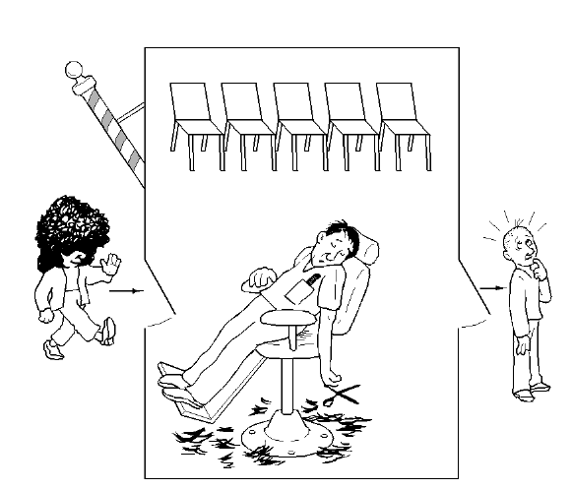
The Sleeping Barber Problem

Slide 65
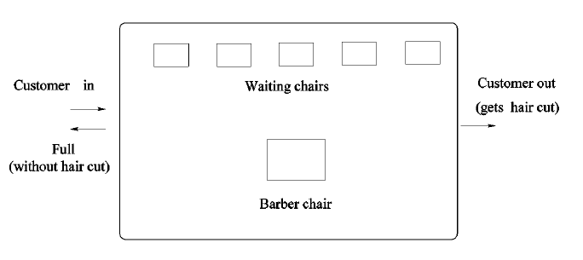
Problem description:

Slide 66
The barber shop has one barber, one barber chair, and n chairs for waiting customers, if any, to sit on.
If there are no customers present, the barber sits down in the barber chair and falls asleep, as shown in the figure in the previous slide
When a customer arrives, he has to wake up the sleeping barber. If additional customers arrive while the barber is cutting a customer’s hair, they either sit down (if there are empty chairs) or leave the shop (if all chairs are full).
The solution uses three semaphores:
customers , which counts waiting customers (excluding the customer in the barber chair, who is not waiting),
barbers , no. of barbers (0 or 1) based on barber is idle/waiting for customers,
mutex , which is used for mutual exclusion.
We also need a variable, waiting , which also counts the waiting customers. It is
essentially a copy of customers .

Slide 67
#define CHAIRS 5 /* number of chairs for waiting customers */
typedef int semaphore;
semaphore customers = 0; /* number of waiting customers */
semaphore barbers = 0; /* number of barbers waiting for customers */
semaphore mutex = 1; /* for mutual exclusion */
int waiting = 0; /* customers are waiting not being haircut */
void Barber(void){
while (TRUE){
down(customers); /* go to sleep if number of customers is 0 */
down(mutex); /* acquire access to ‘waiting’ */
waiting = waiting – 1; /* decrement count of waiting customers */
up(barbers); /* one barber is now ready to cut hair */
up(mutex); /* release ‘waiting’ */
cut_hair(); /* cut hair, non-CS */
}}

Slide 68
void customer(void){
down(mutex); /* enter CS */
if (waiting < CHAIRS){
waiting = waiting + 1; /* increment count of waiting customers */
up(customers); /* wake up barber if necessary */
up(mutex); /* release access to ‘waiting’ */
down(barbers); /* wait if no free barbers */
get_haircut(); /* non-CS */
}else{
up(mutex); /* shop is full, do not wait */
}
}
Figure. A solution to the Sleeping Barber Problem

